Slide 1
2018 Student Opioid Summit

Slide 2
Background

Slide 3
Notes:
Student designed logo by Noah Watson-Pratt

Slide 4
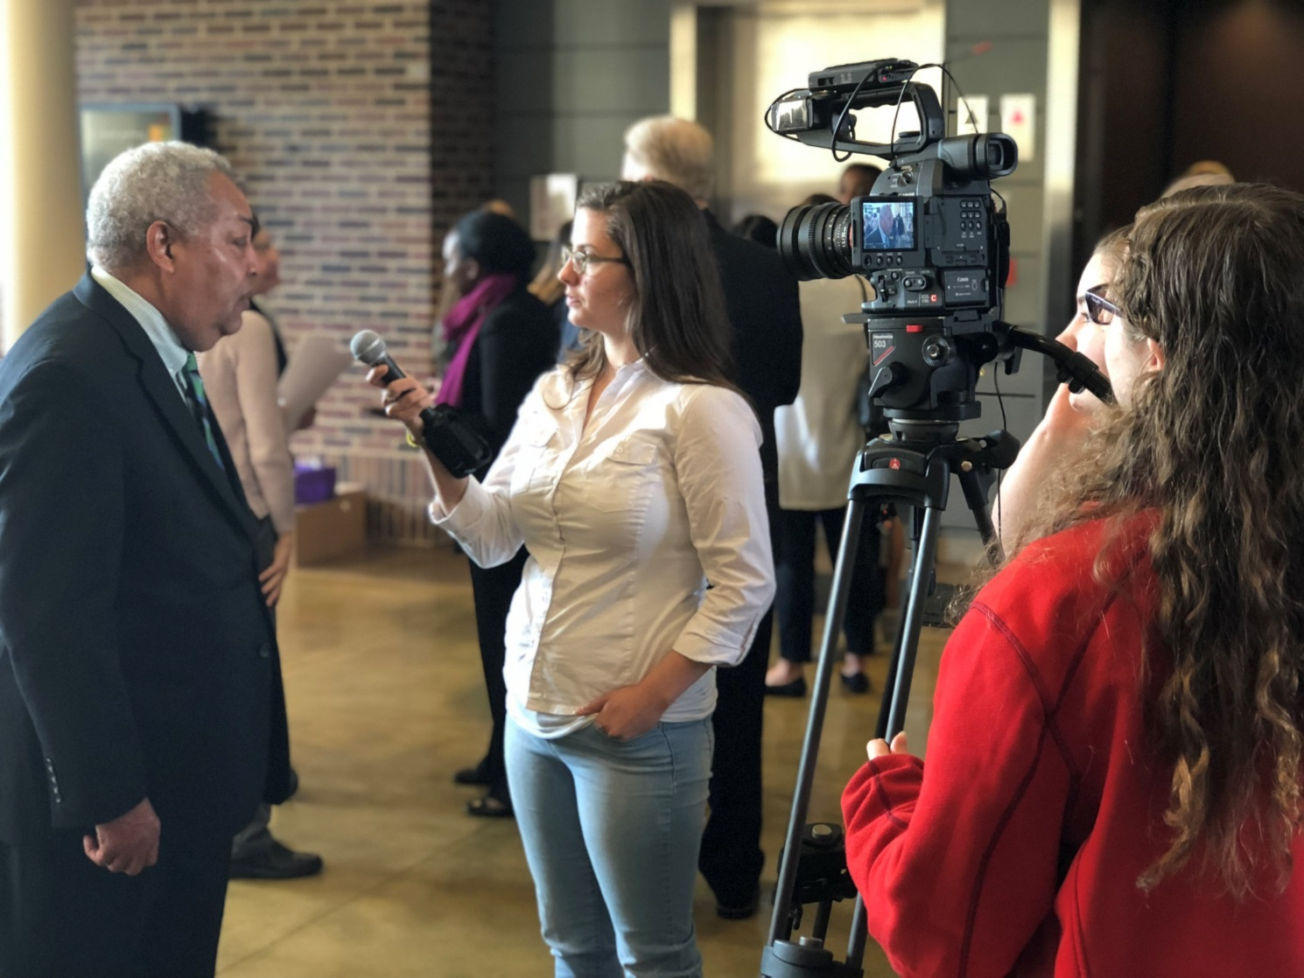
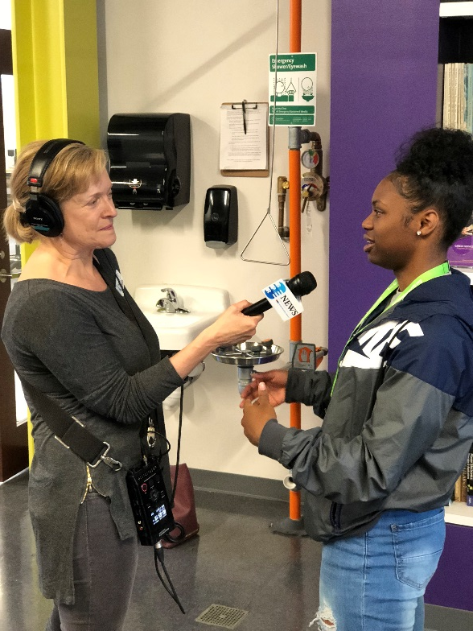

Slide 5
14 Schools...

Slide 6
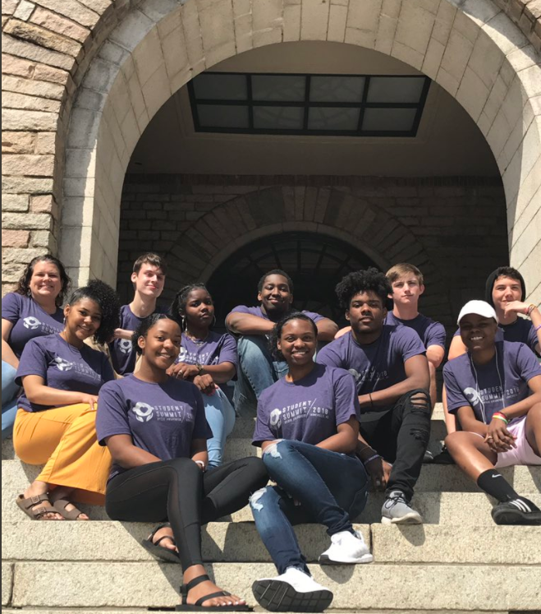
Title Only

Slide 7
